Slide 2
Answer the public
https://answerthepublic.com/
Find out what questions and queries your consumers have by getting a free report of what they're searching for in Google.

Slide 3
Canva
https://www.canva.com/
Canva is a web-based tool that lets you create stunning visuals for your blogs and social media. Canva offers pre-sized social media images for various platforms, and it is also a good tool for creating images for marketing materials, presentations, ads, infographics, etc.

Slide 4
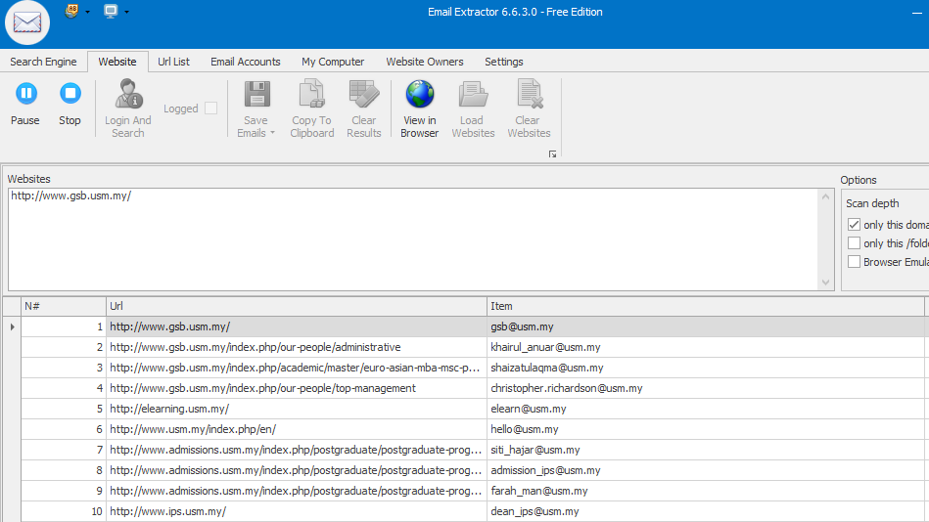
Email Extractor

Slide 5
Feedly
https://feedly.com/
Feedly is a news aggregator application for various web browsers and mobile devices running iOS and Android, also available as a cloud-based service. It compiles news feeds from a variety of online sources for the user to customize and share with others.

Slide 6
Gtmetrix
https://gtmetrix.com/analyze.html
GTmetrix is a free tool that analyzes your website’s speed by checking both PageSpeed and YSlow metrics. It also suggests dozens of different ways to improve your website speed performance.
The basic functionality of GTMetrix is free and you can analyze the speed of your website right from the service’s homepage

Slide 7
Google trends
https://trends.google.com.bd/
Google Trends is a website by Google that analyzes the popularity of top search queries in Google Search across various regions and languages.

Slide 8
Hotjar
https://www.hotjar.com/
Hotjar is a tool that offers some interesting metrics that you cannot get from Google Analytics. It shows the behavior of your website visitors via heatmaps, clickmaps, scrollmaps, and visitor recordings.

Slide 9
Tawk.to
https://www.tawk.to/
tawk.to is a free app that lets you monitor and chat with your website visitors in real time and from any device.
Setup is quite simple – just copy a simple line of Javascript into the HTML of your website and the chat widget will immediately start working.

